Slide 1
By
F. Ghavipanjeh
f.ghavipanjeh@gmail.com

Slide 2
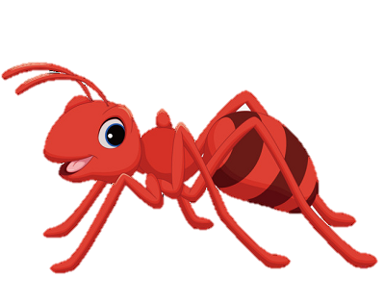
ant

Slide 3
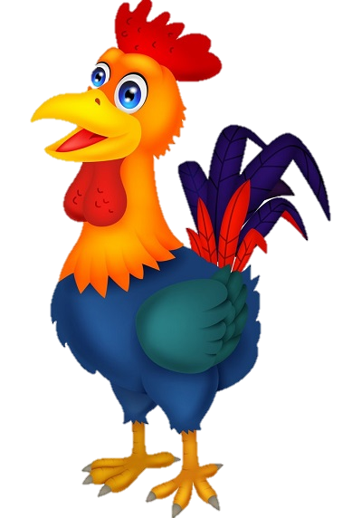
rooster

Slide 4
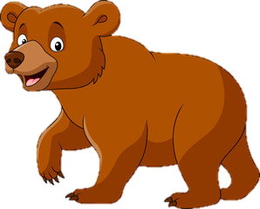
bear

Slide 5
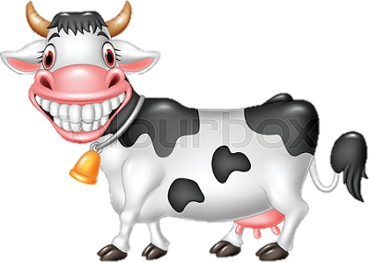
cow

